Slide 1
RUSTikales Rust for beginners
©Philippe Felix Haupt 2023-2024

Slide 2
Plan for today
©Philippe Felix Haupt 2023-2024

Slide 3
Plan for today
Recap
©Philippe Felix Haupt 2023-2024

Slide 4
Plan for today
Recap
Generics
©Philippe Felix Haupt 2023-2024

Slide 5
Recap
©Philippe Felix Haupt 2023-2024

Slide 6
Recap
Ownership
Borrowing
Borrow Checker
©Philippe Felix Haupt 2023-2024

Slide 7
Recap
Ownership
Borrowing
Borrow Checker
Structs
Traits
©Philippe Felix Haupt 2023-2024

Slide 8
Recap
Ownership
Borrowing
Borrow Checker
Structs
Traits
Enums
Enum values are part of a finite set of Enum Variants
Types of dog breeds is finite
Token types in a compiler is a finite, known set
Declared using enum <enum_name> { <enum_variants> }
Using <enum_name>::<enum_variant> creates an Enum value
©Philippe Felix Haupt 2023-2024

Slide 9
Recap
Ownership
Borrowing
Borrow Checker
Structs
Traits
Enums
Pattern Matching
match allows us to control the flow of the program, even better than a simple if-else
Allows us to access attached data behind Enum variants
Allows us to bind values to variables
Very powerful, almost everything in Rust uses it
©Philippe Felix Haupt 2023-2024

Slide 10
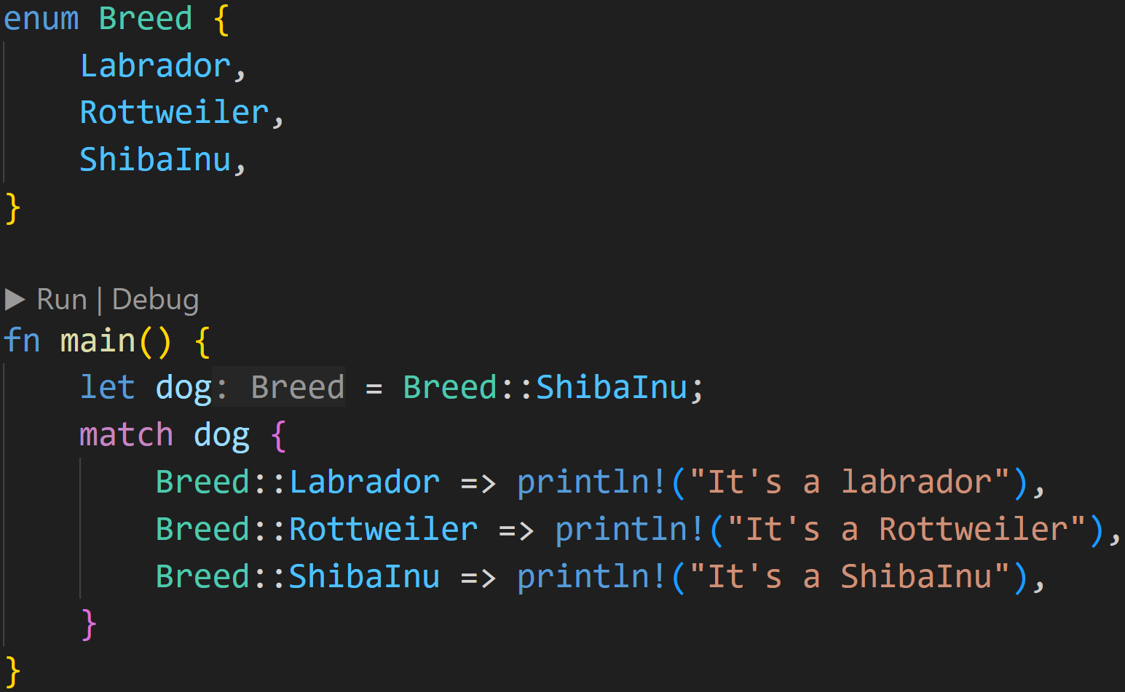
Recap
©Philippe Felix Haupt 2023-2024

Slide 11
Recap
Declare Enum with 3 Variants:
Breed::Labrador
Breed::Rottweiler
Breed::ShibaInu
Create Enum value
©Philippe Felix Haupt 2023-2024

Slide 12
Recap
match allows us to easily check for patterns, here it means:
if dog matches Breed::Labrador, print “It’s a Labrador” if dog matches Breed::Rottweiler, print “It’s a Rottweiler”
if dog matches Breed::ShibaInu, print “It’s a ShibaInu”
©Philippe Felix Haupt 2023-2024

Slide 13
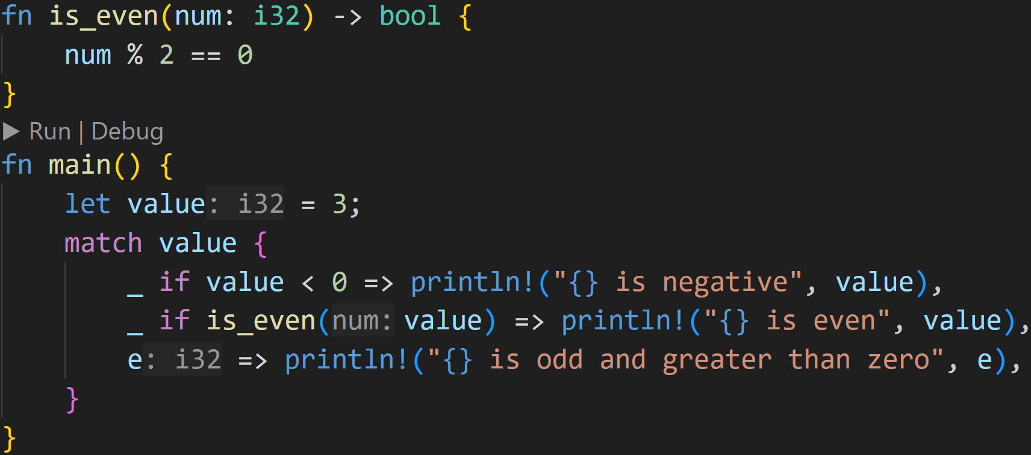
Recap
©Philippe Felix Haupt 2023-2024

Slide 14
Recap
Patterns are very expressive, you can also add conditions
©Philippe Felix Haupt 2023-2024

Slide 15
Recap
Patterns are very expressive, you can also add conditions
If this pattern matches, you can use e as a variable inside the code block after the =>, it has the value of value
©Philippe Felix Haupt 2023-2024

Slide 16
Recap
1/3
What is the output of this program?
©Philippe Felix Haupt 2023-2024

Slide 17

Recap
1/3
What is the output of this program?
©Philippe Felix Haupt 2023-2024

Slide 18
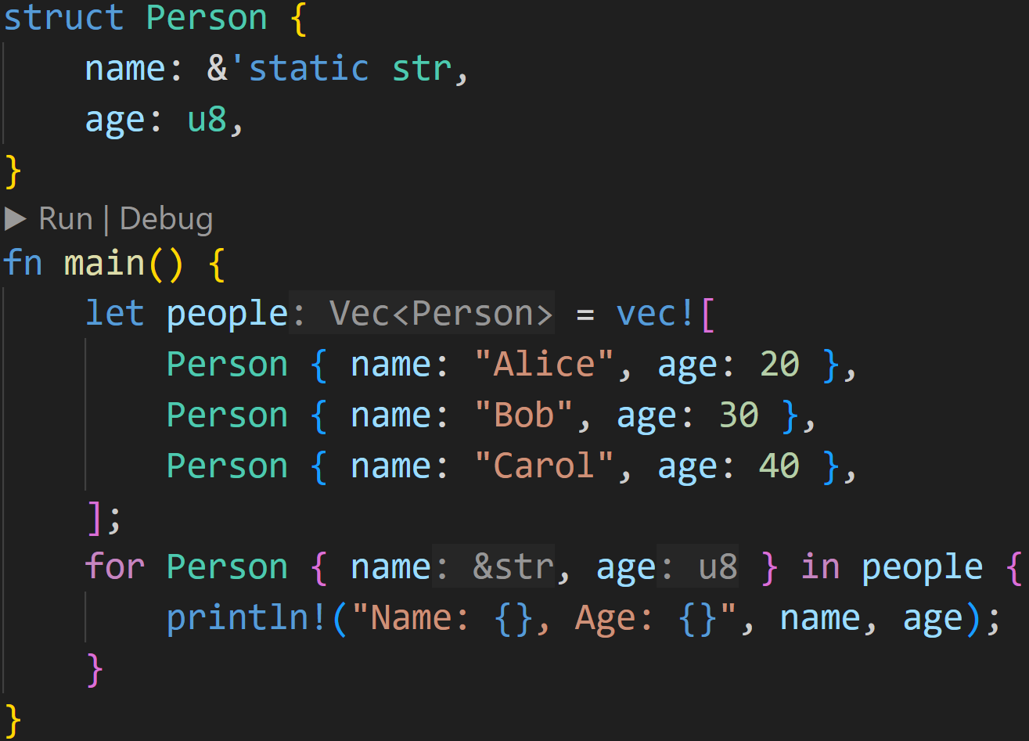
Recap
©Philippe Felix Haupt 2023-2024

Slide 19
Recap
yes, even for uses Pattern Matching :)
Here we destructure the struct and access its fields, which can be used as variables name and age inside the for-block
©Philippe Felix Haupt 2023-2024

Slide 20
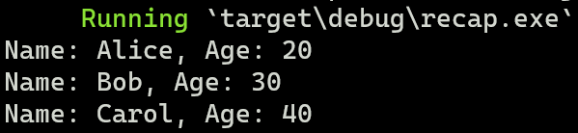
Recap
yes, even for uses Pattern Matching :)
Here we destructure the struct and access its fields, which can be used as variables name and age inside the for-block
©Philippe Felix Haupt 2023-2024

Slide 21
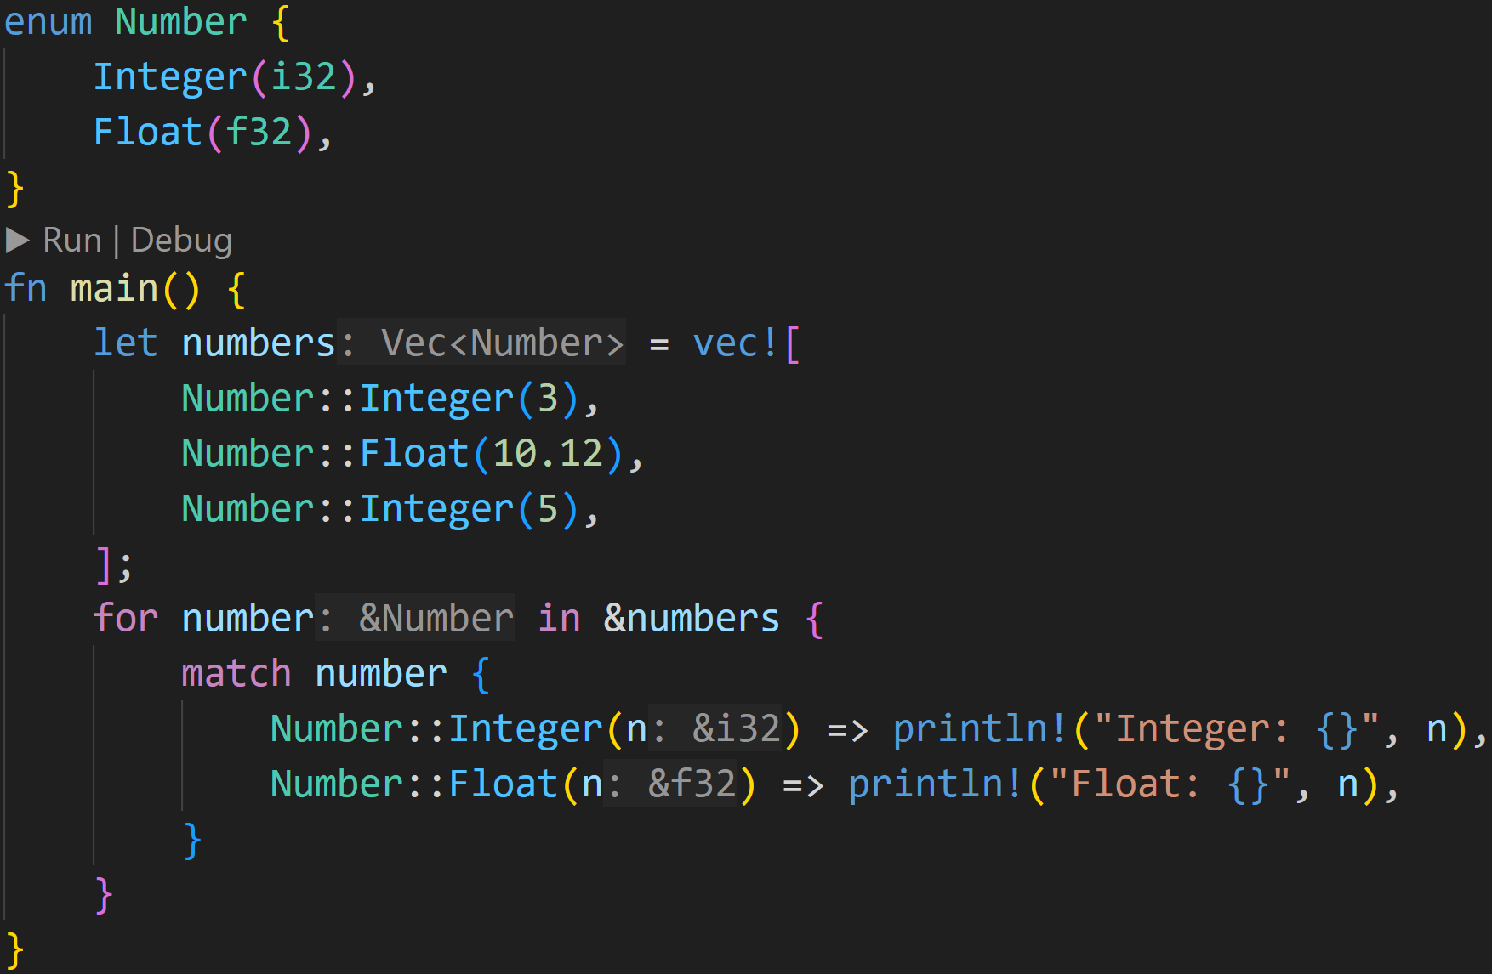
Recap
©Philippe Felix Haupt 2023-2024

Slide 22
Recap
Rust allows us to attach data to Enums, here each Number::Integer gets an i32
©Philippe Felix Haupt 2023-2024

Slide 23
Recap
Rust allows us to attach data to Enums, here each Number::Integer gets an i32
Create Enum values by providing that data
©Philippe Felix Haupt 2023-2024

Slide 24
Recap
Rust allows us to attach data to Enums, here each Number::Integer gets an i32
Create Enum values by providing that data
Use Pattern Matching to access that data
©Philippe Felix Haupt 2023-2024

Slide 25
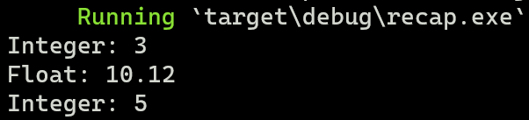
Recap
Rust allows us to attach data to Enums, here each Number::Integer gets an i32
Create Enum values by providing that data
Use Pattern Matching to access that data
©Philippe Felix Haupt 2023-2024

Slide 26
Generics
©Philippe Felix Haupt 2023-2024

Slide 27
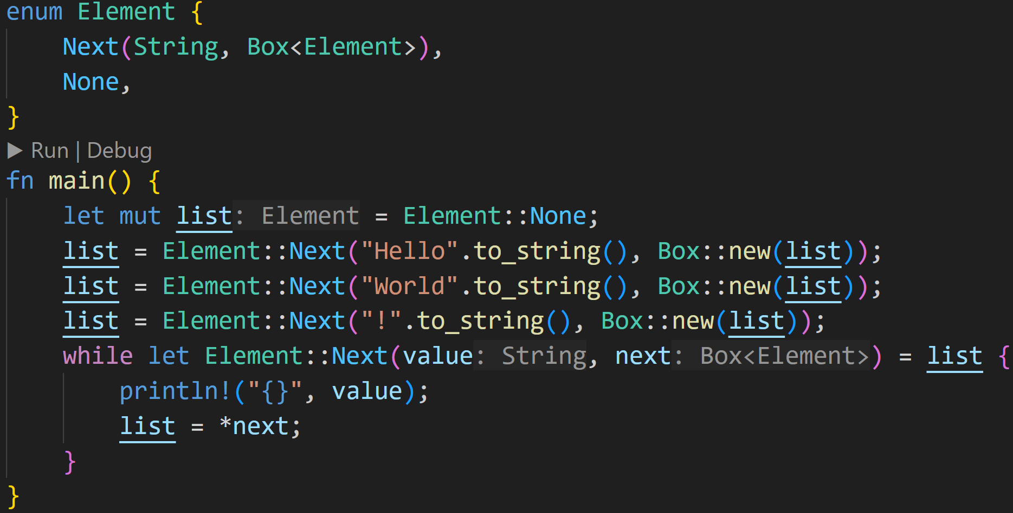
Generics
Today’s starting point is the Linked List we were using last week:
©Philippe Felix Haupt 2023-2024

Slide 28
Generics
Today’s starting point is the Linked List we were using last week
Now imagine you want to create more lists:
Create a List of i32
Create a List of bool
Create a List of Lists
©Philippe Felix Haupt 2023-2024

Slide 29
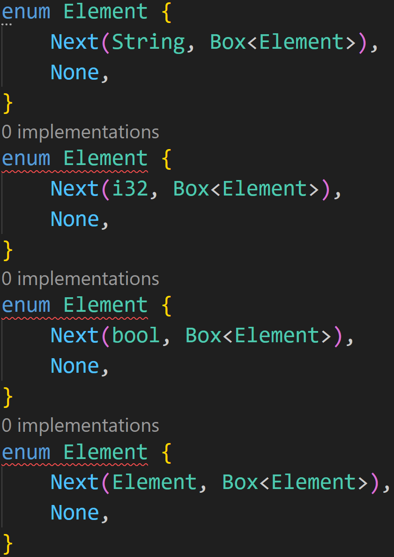
Generics
This is already semi-doable with our knowledge:
©Philippe Felix Haupt 2023-2024

Slide 30
Generics
This is already semi-doable with our knowledge:
However, as we can see, the red wiggly lines of doom are here to ruin our day
©Philippe Felix Haupt 2023-2024

Slide 31
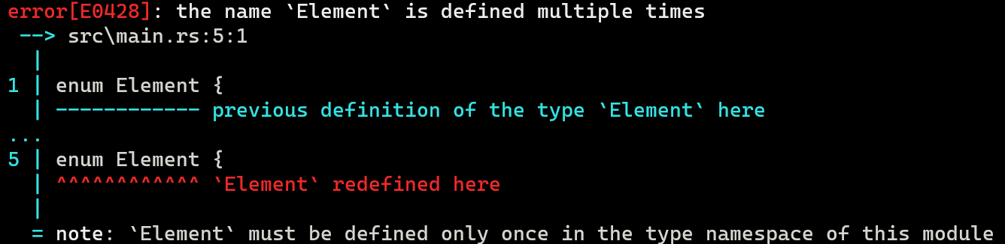
Generics
This is already semi-doable with our knowledge:
However, as we can see, the red wiggly lines of doom are here to ruin our day
Makes sense
©Philippe Felix Haupt 2023-2024

Slide 32
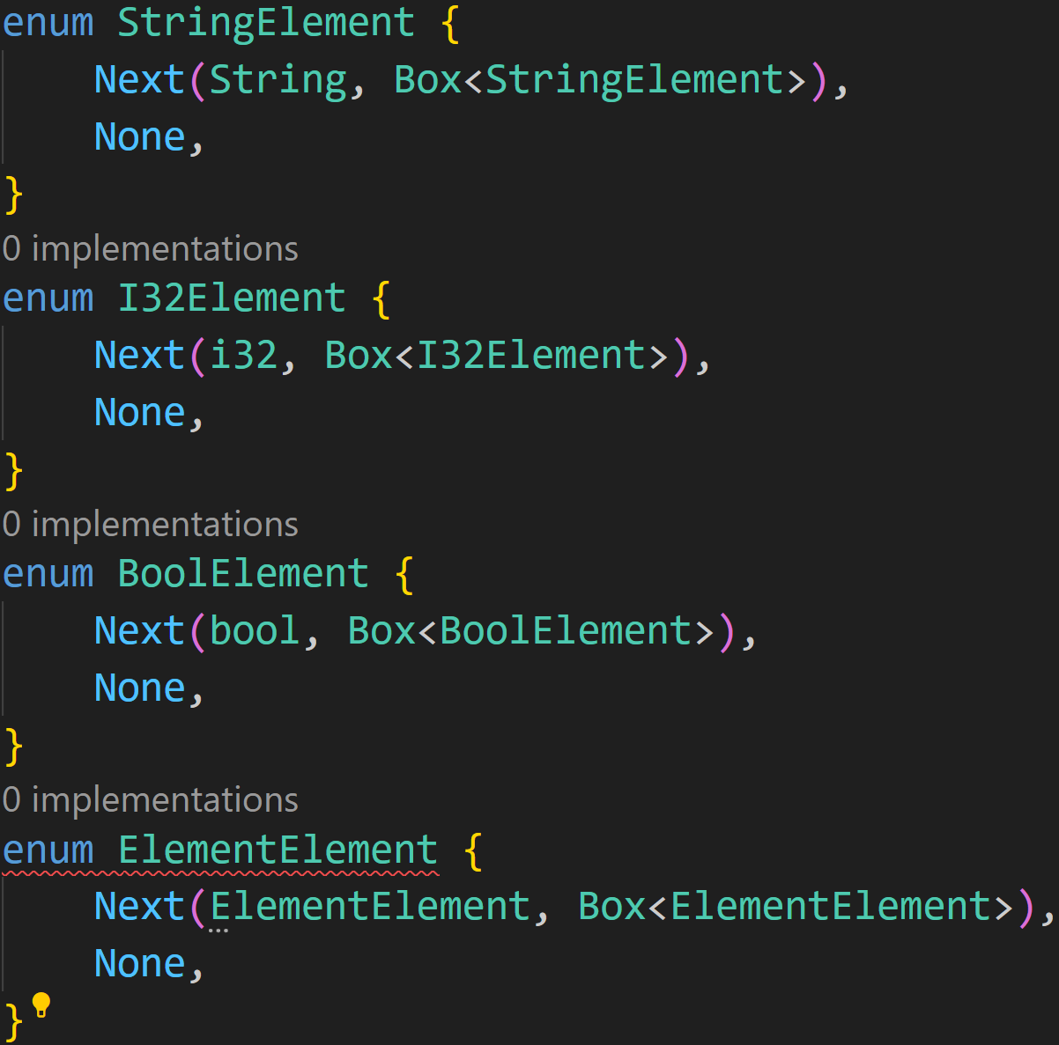
Generics
This is already semi-doable with our knowledge:
However, as we can see, the red wiggly lines of doom are here to ruin our day
But we can attempt to fix that:
©Philippe Felix Haupt 2023-2024

Slide 33
Generics
There’s a problem (besides the recursion for the last Enum) with this approach, namely: We need to now implement any method we want to implement, many times, once each for each List
©Philippe Felix Haupt 2023-2024

Slide 34
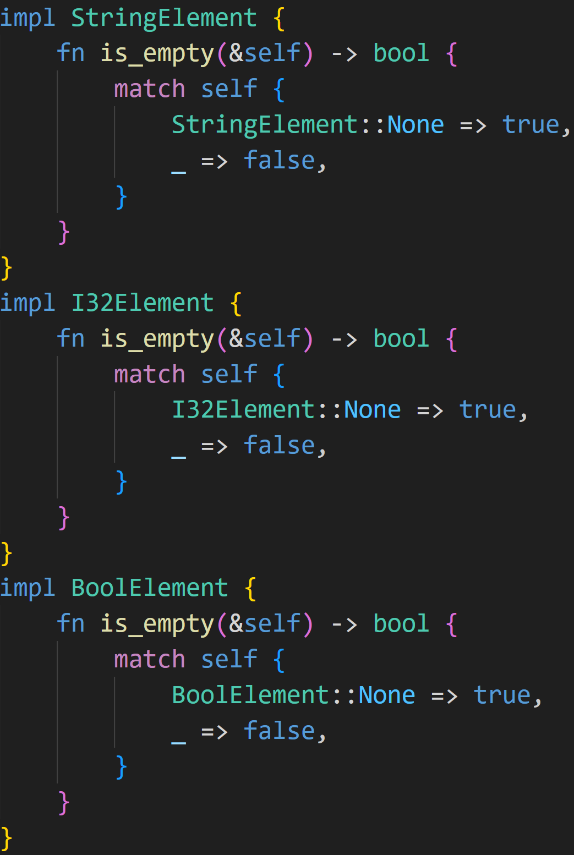
Generics
©Philippe Felix Haupt 2023-2024

Slide 35
Generics
There’s a problem (besides the recursion for the last Enum) with this approach, namely: We need to now implement any method we want to implement, many times, once each for each List
Additionally, as we’ve seen with our Shape problem in the last session, managing those Enums is now harder than it needs to be:
Incompatible
A lot of management needed
A lot of code
©Philippe Felix Haupt 2023-2024

Slide 36
Generics
There’s a problem (besides the recursion for the last Enum) with this approach, namely: We need to now implement any method we want to implement, many times, once each for each List
Additionally, as we’ve seen with our Shape problem in the last session, managing those Enums is now harder than it needs to be:
Incompatible
A lot of management needed
A lot of code
For every additional Type we want to support (for example, VecElement) we need to implement all other methods again, leading to even more code
©Philippe Felix Haupt 2023-2024

Slide 37
Generics
There’s a problem (besides the recursion for the last Enum) with this approach, namely: We need to now implement any method we want to implement, many times, once each for each List
Additionally, as we’ve seen with our Shape problem in the last session, managing those Enums is now harder than it needs to be:
Incompatible
A lot of management needed
A lot of code
For every additional Type we want to support (for example, VecElement) we need to implement all other methods again, leading to even more code
This is where Generic Types enter the playing field
©Philippe Felix Haupt 2023-2024

Slide 38
Generics
Generics, similar to traits, allow us to generalize our code
©Philippe Felix Haupt 2023-2024

Slide 39
Generics
Generics, similar to traits, allow us to generalize our code
Traits will be important later on, when we get to trait bounds
©Philippe Felix Haupt 2023-2024

Slide 40
Generics
Generics, similar to traits, allow us to generalize our code
Traits will be important later on, when we get to trait bounds
We can use Generics to create Structs and Enums that have any type as a field, and create functions that take in any type as parameter
©Philippe Felix Haupt 2023-2024

Slide 41
Generics
Generics, similar to traits, allow us to generalize our code
Traits will be important later on, when we get to trait bounds
We can use Generics to create Structs and Enums that have any type as a field, and create functions that take in any type as parameter
Generic Types are specified using <> in Rust
©Philippe Felix Haupt 2023-2024

Slide 42
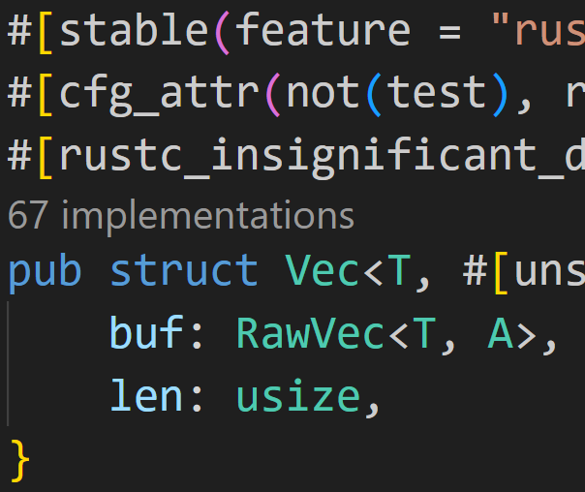
Generics
Generics, similar to traits, allow us to generalize our code
Traits will be important later on, when we get to trait bounds
We can use Generics to create Structs and Enums that have any type as a field, and create functions that take in any type as parameter
Generic Types are specified using <> in Rust
We’ve seen that before when using Vectors!
Vector is defined as Vec<T>
©Philippe Felix Haupt 2023-2024

Slide 43
Generics
Generics, similar to traits, allow us to generalize our code
Traits will be important later on, when we get to trait bounds
We can use Generics to create Structs and Enums that have any type as a field, and create functions that take in any type as parameter
Generic Types are specified using <> in Rust
Instead of defining each List individually, we can make the first type of Element::Next generic:
©Philippe Felix Haupt 2023-2024

Slide 44
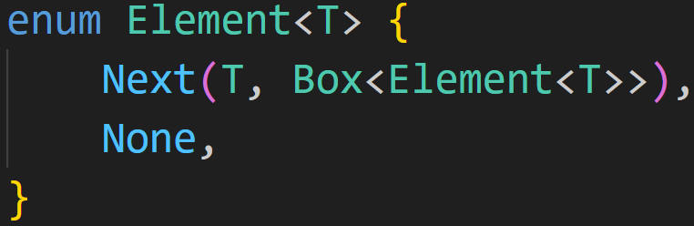
Generics
©Philippe Felix Haupt 2023-2024

Slide 45
Generics
This type T is a Generic Type, it’s like a template:
Later on, when defining Elements, T is replaced with the actual type, i32 for example
©Philippe Felix Haupt 2023-2024

Slide 46
Generics
This type T is a Generic Type, it’s like a template:
Later on, when defining Elements, T is replaced with the actual type, i32 for example
Use of Generic Type T here, will later be replaced with actual type
©Philippe Felix Haupt 2023-2024

Slide 47
Generics
This type T is a Generic Type, it’s like a template:
Later on, when defining Elements, T is replaced with the actual type, i32 for example
Use of Generic Type T here, will later be replaced with actual type
This declaration defines a Generic Enum, it can theoretically* be a List over any type you can think of
©Philippe Felix Haupt 2023-2024

Slide 48
Generics
This type T is a Generic Type, it’s like a template:
Later on, when defining Elements, T is replaced with the actual type, i32 for example
Use of Generic Type T here, will later be replaced with actual type
This declaration defines a Generic Enum, it can theoretically* be a List over any type you can think of
(Theoretically because Trait bounds are a thing, for example T must be Sized)
©Philippe Felix Haupt 2023-2024

Slide 49
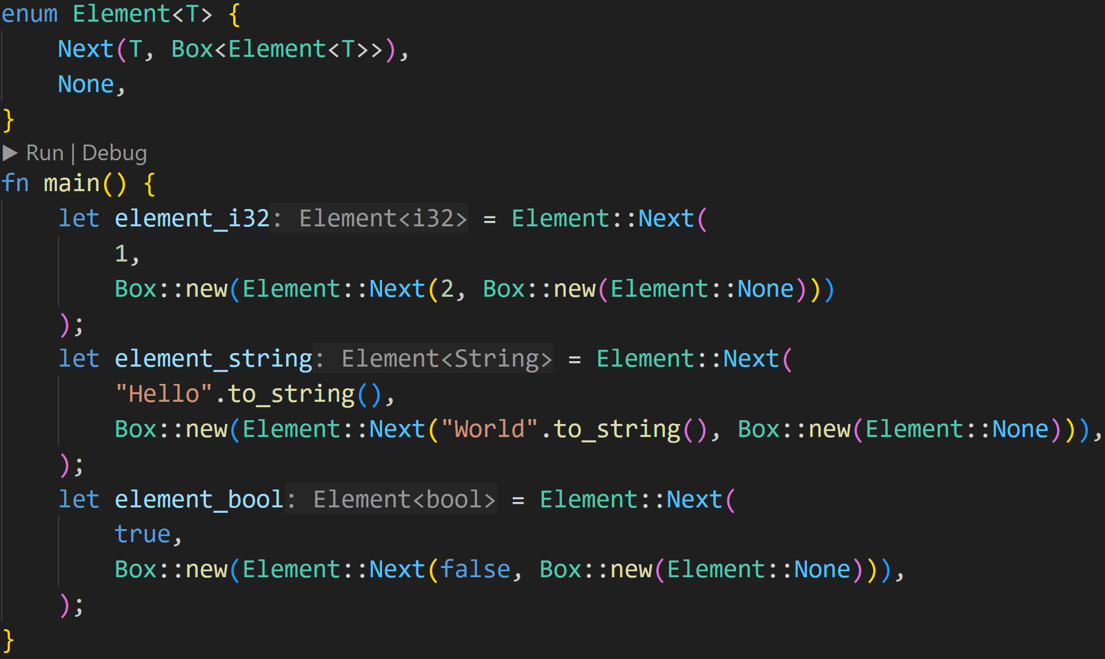
Generics
©Philippe Felix Haupt 2023-2024

Slide 50
Generics
With this one generic definition we are able to generate any Lists we want:
List of i32
©Philippe Felix Haupt 2023-2024

Slide 51
Generics
With this one generic definition we are able to generate any Lists we want:
List of i32
List of String
©Philippe Felix Haupt 2023-2024

Slide 52
Generics
With this one generic definition we are able to generate any Lists we want:
List of i32
List of String
List of bool
©Philippe Felix Haupt 2023-2024

Slide 53
Generics
However, we’re currently very limited:
Because Rust needs to assume the worst case for T, we can’t do much with those Elements
©Philippe Felix Haupt 2023-2024

Slide 54
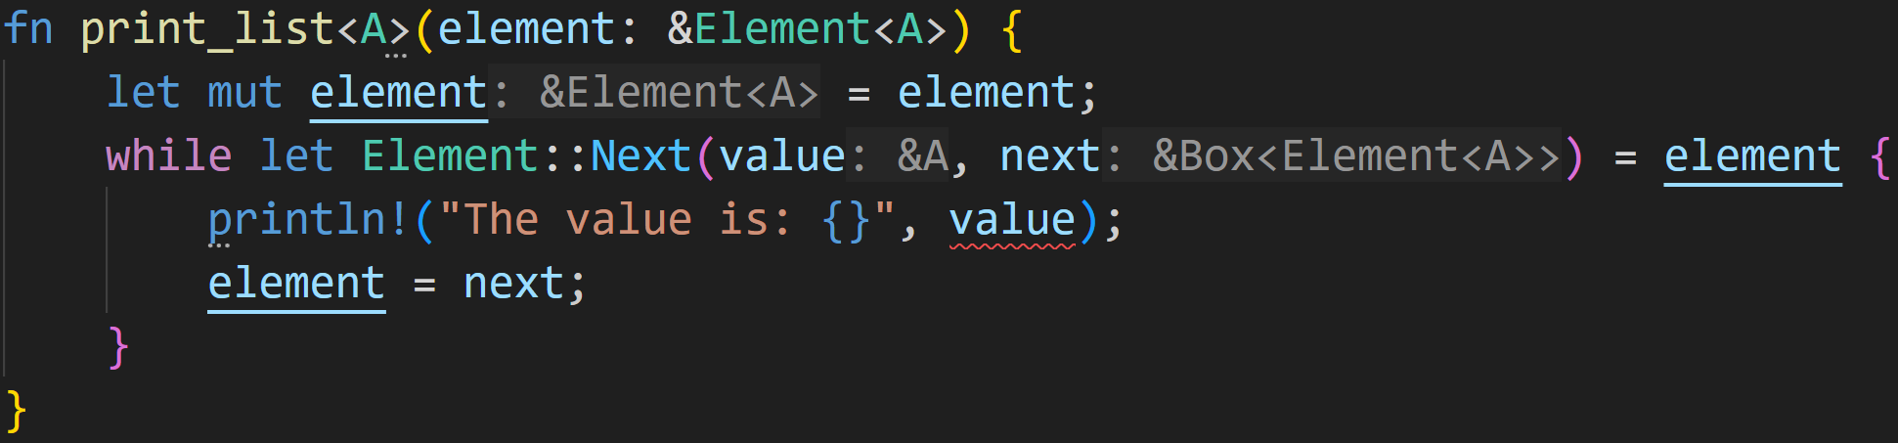
Intermission - Trait Bounds
©Philippe Felix Haupt 2023-2024

Slide 55
Intermission - Trait Bounds
We can also make functions generic
©Philippe Felix Haupt 2023-2024

Slide 56
Intermission - Trait Bounds
Didn’t we define Element<T> a few slides earlier?
More on that in a few slides
©Philippe Felix Haupt 2023-2024

Slide 57
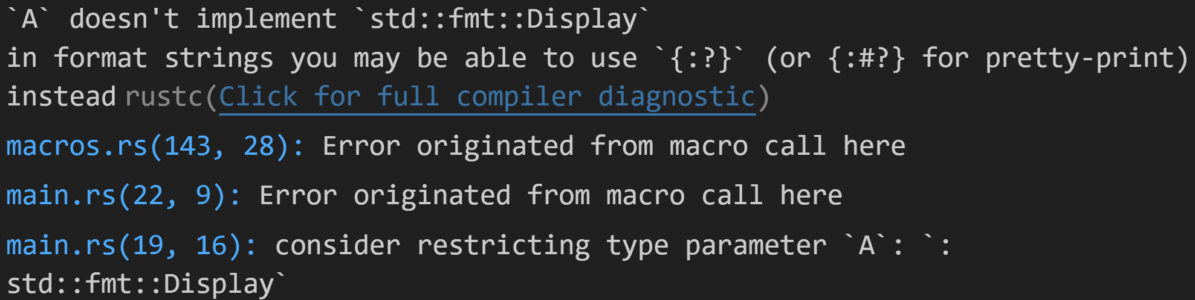
Intermission - Trait Bounds
©Philippe Felix Haupt 2023-2024

Slide 58
Intermission - Trait Bounds
The problem is simple:
As we’ve learned, many things in Rust are opt-in via Traits, for example printing to the console
There are certain cases where we don’t want to (or sometimes can’t) implement a given Trait for a Type
©Philippe Felix Haupt 2023-2024

Slide 59
Intermission - Trait Bounds
The problem is simple:
As we’ve learned, many things in Rust are opt-in via Traits, for example printing to the console
There are certain cases where we don’t want to (or sometimes can’t) implement a given Trait for a Type
Because those things are opt-in, we need to implement Trait Boundaries for when we want to call the function:
Boundaries are compile-time rules that guarantee that a given Generic Type implements a Trait
If the Type does not implement the Trait, we get an Error and can’t run the code
©Philippe Felix Haupt 2023-2024

Slide 60
Intermission - Trait Bounds
The problem is simple:
As we’ve learned, many things in Rust are opt-in via Traits, for example printing to the console
There are certain cases where we don’t want to (or sometimes can’t) implement a given Trait for a Type
Because those things are opt-in, we need to implement Trait Boundaries for when we want to call the function:
Boundaries are compile-time rules that guarantee that a given Generic Type implements a Trait
If the Type does not implement the Trait, we get an Error and can’t run the code
Here Rust recommends we add the restriction that A needs to implement Display, which we can easily do
©Philippe Felix Haupt 2023-2024

Slide 61
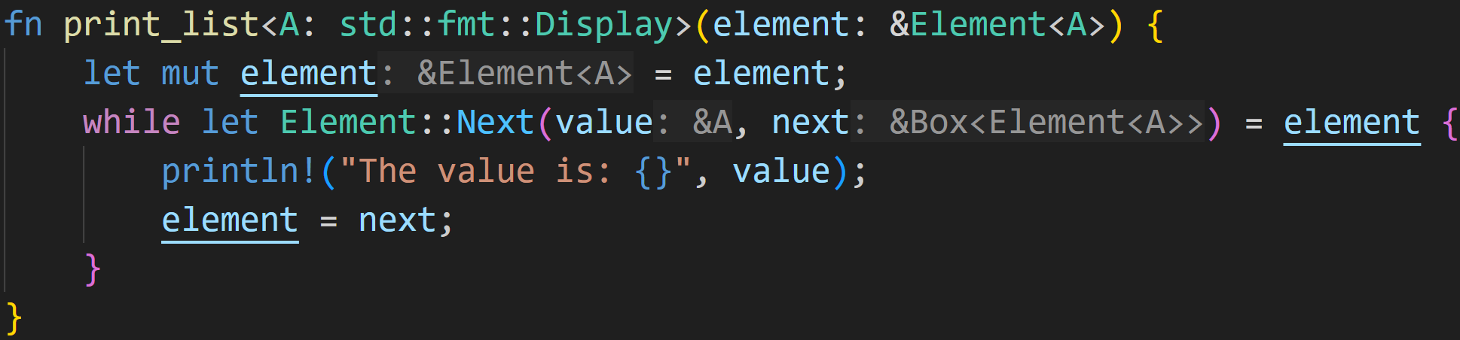
Intermission - Trait Bounds
This is a Trait Bound:
Instead of accepting every type, we now only accept types that implement the Display trait
©Philippe Felix Haupt 2023-2024

Slide 62
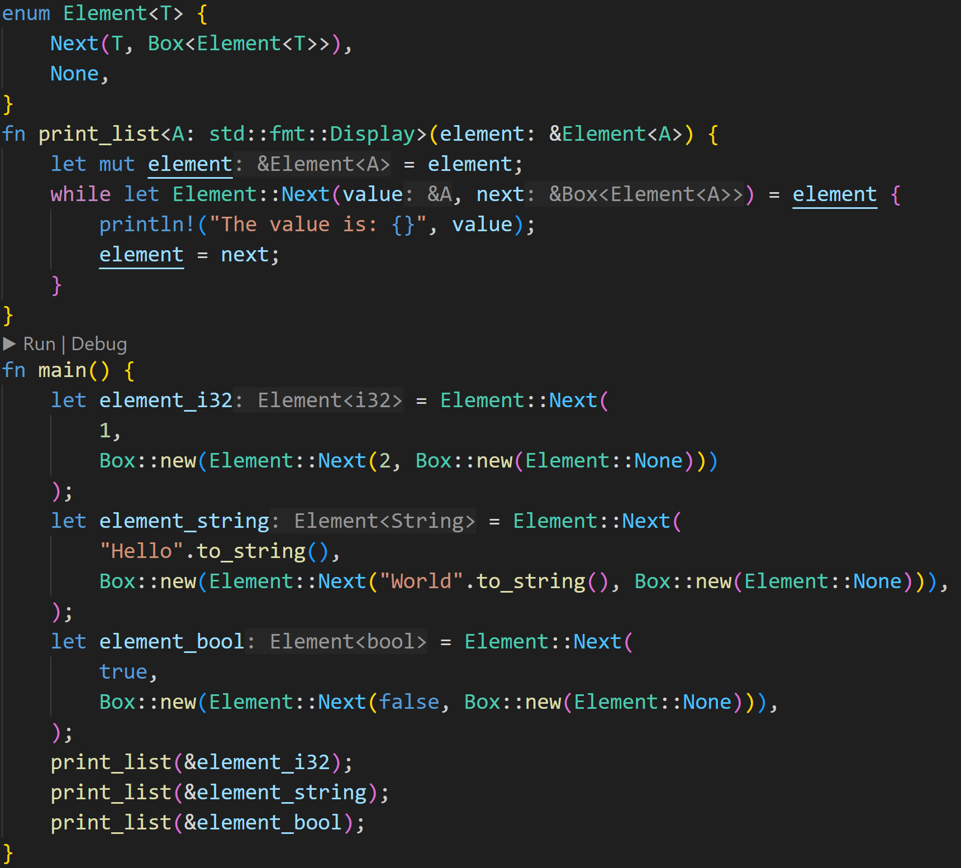
Generics
©Philippe Felix Haupt 2023-2024

Slide 63
Generics
Generic Enum
Generic Function
Create variants of the Generic Enum
Call variants of the Generic Function
©Philippe Felix Haupt 2023-2024

Slide 64
Generics
Now, how does Rust do this?
Also, we defined Element<T>, but passed Element<A> as parameter, how?
©Philippe Felix Haupt 2023-2024

Slide 65
Generics
Now, how does Rust do this?
Also, we defined Element<T>, but passed Element<A> as parameter, how?
Truth is, those are two different generic types that have nothing to do with each other
©Philippe Felix Haupt 2023-2024

Slide 66
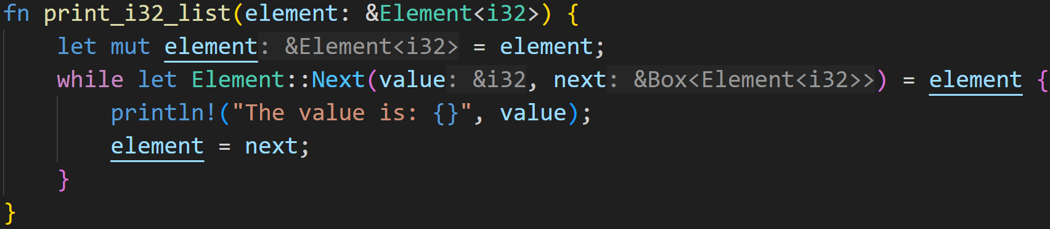
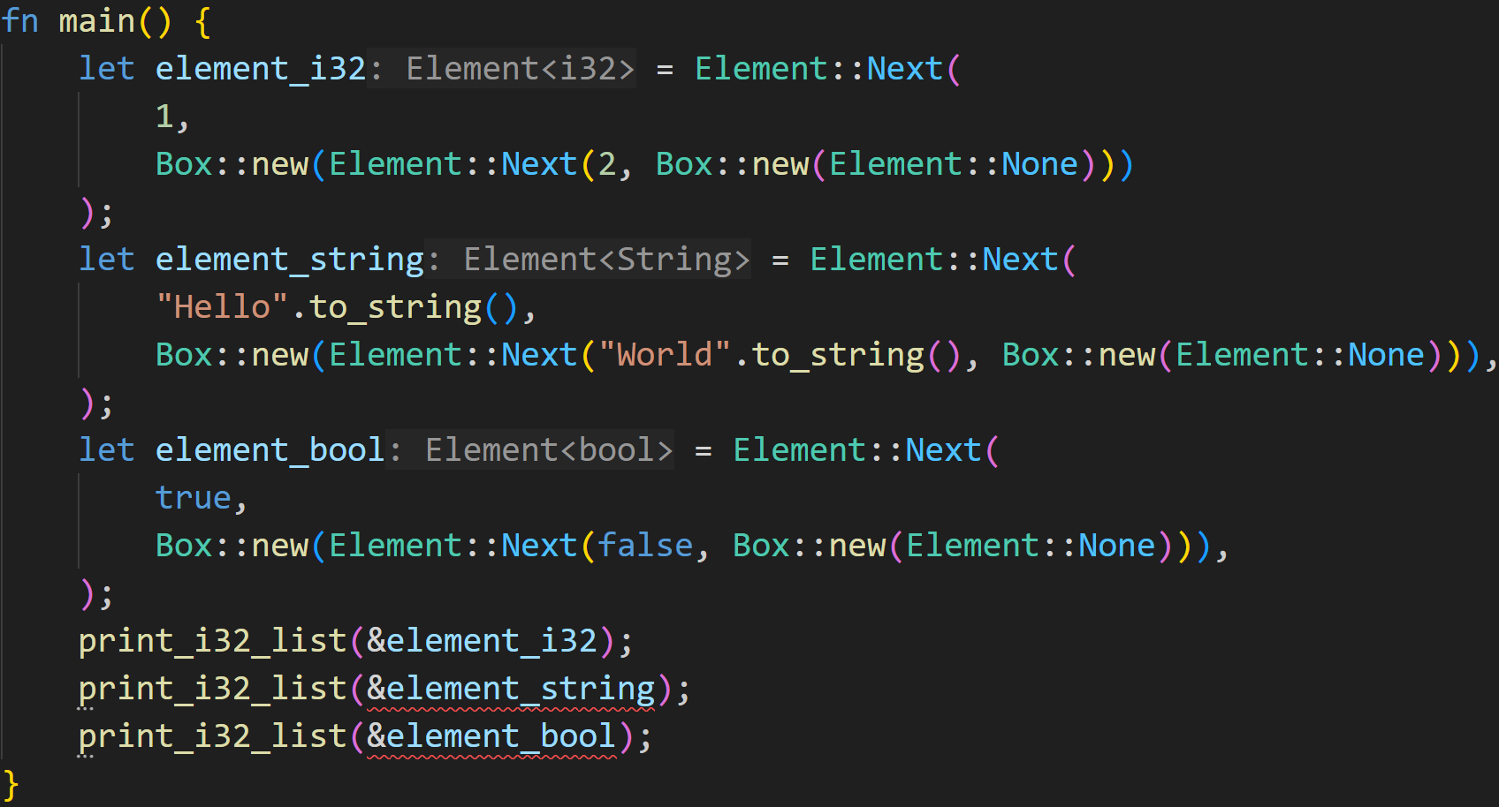
Generics
Now, how does Rust do this?
Also, we defined Element<T>, but passed Element<A> as parameter, how?
Truth is, those are two different generic types that have nothing to do with each other
We could’ve also defined a function that takes in an Element<i32>, without making the function generic
©Philippe Felix Haupt 2023-2024

Slide 67
Generics
Now, how does Rust do this?
Also, we defined Element<T>, but passed Element<A> as parameter, how?
Truth is, those are two different generic types that have nothing to do with each other
We could’ve also defined a function that takes in an Element<i32>, without making the function generic
Now, of course this will fail, because Element<String> != Element<i32>
©Philippe Felix Haupt 2023-2024

Slide 68
Generics
Now, how does Rust do this?
Also, we defined Element<T>, but passed Element<A> as parameter, how?
Truth is, those are two different generic types that have nothing to do with each other
We could’ve also defined a function that takes in an Element<i32>, without making the function generic
Rust performs static dispatch, in contrast to dynamic dispatch in languages such as Java
(dynamic dispatch is also possible in Rust using the dyn keyword)
©Philippe Felix Haupt 2023-2024

Slide 69
Generics
Now, how does Rust do this?
Also, we defined Element<T>, but passed Element<A> as parameter, how?
Truth is, those are two different generic types that have nothing to do with each other
We could’ve also defined a function that takes in an Element<i32>, without making the function generic
Rust performs static dispatch, in contrast to dynamic dispatch in languages such as Java
This means that at compile-time it emits code for every generic type you use, instead of figuring that out at runtime
Pro: Faster code execution
Con: Executable is bigger
©Philippe Felix Haupt 2023-2024

Slide 70
Generics
In our case, Rust notices that we use 3 versions of print_list:
print_list<i32>
print_list<String>
print_list<bool>
©Philippe Felix Haupt 2023-2024

Slide 71
Generics
In our case, Rust notices that we use 3 versions of print_list:
print_list<i32>
print_list<String>
print_list<bool>
For each of those, it checks if the type implements Display, which i32, String and bool all do
©Philippe Felix Haupt 2023-2024

Slide 72
Generics
In our case, Rust notices that we use 3 versions of print_list:
print_list<i32>
print_list<String>
print_list<bool>
and generates 3 versions of the code:
print_list_i32(element: &Element<i32>)
print_list_String(element: &Element<String>)
print_list_bool(element: &Element<bool>)
©Philippe Felix Haupt 2023-2024

Slide 73
Generics
In our case, Rust notices that we use 3 versions of print_list:
print_list<i32>
print_list<String>
print_list<bool>
and generates 3 versions of the code:
print_list_i32(element: &Element<i32>)
print_list_String(element: &Element<String>)
print_list_bool(element: &Element<bool>)
Only at this point does it look at Element<T> itself, and generates three versions of the Enum as well:
enum Element_i32 { … }
enum Element_String { … }
enum Element_bool { … }
©Philippe Felix Haupt 2023-2024

Slide 74
Generics
Of course, we can now implement our Enum or Struct as we’d usually do
©Philippe Felix Haupt 2023-2024

Slide 75
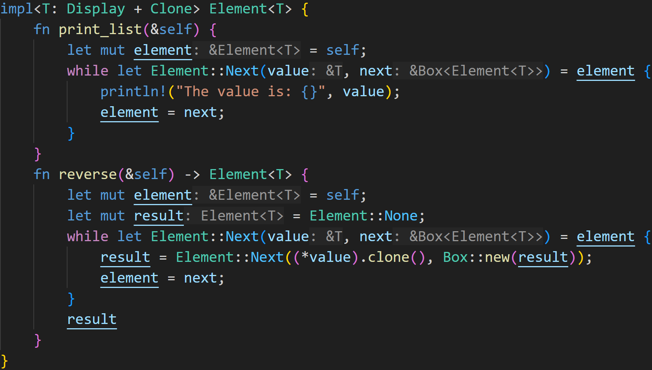
Generics
©Philippe Felix Haupt 2023-2024

Slide 76
Generics
Generic Types and Trait Bounds need to be defined after the impl
©Philippe Felix Haupt 2023-2024

Slide 77
Generics
Trait Bounds:
We need Display for println!
©Philippe Felix Haupt 2023-2024

Slide 78
Generics
Trait Bounds:
We need Display for println!
We need Clone for .clone()
©Philippe Felix Haupt 2023-2024

Slide 79
Generics
The previously said thing still applies:
Rust generates code for every Generic Type you use, it will for example create a function that takes in an Element<i32> instance, and returns an Element<i32> instance when you call reverse()
©Philippe Felix Haupt 2023-2024

Slide 80
Generics
It will not create a method that takes in an Element<i32> and returns an Element<String>, because we use the same Generic Type for the implementation and return type.
©Philippe Felix Haupt 2023-2024

Slide 81
Generics
For Element<i32>, value will be of type &i32
©Philippe Felix Haupt 2023-2024

Slide 82
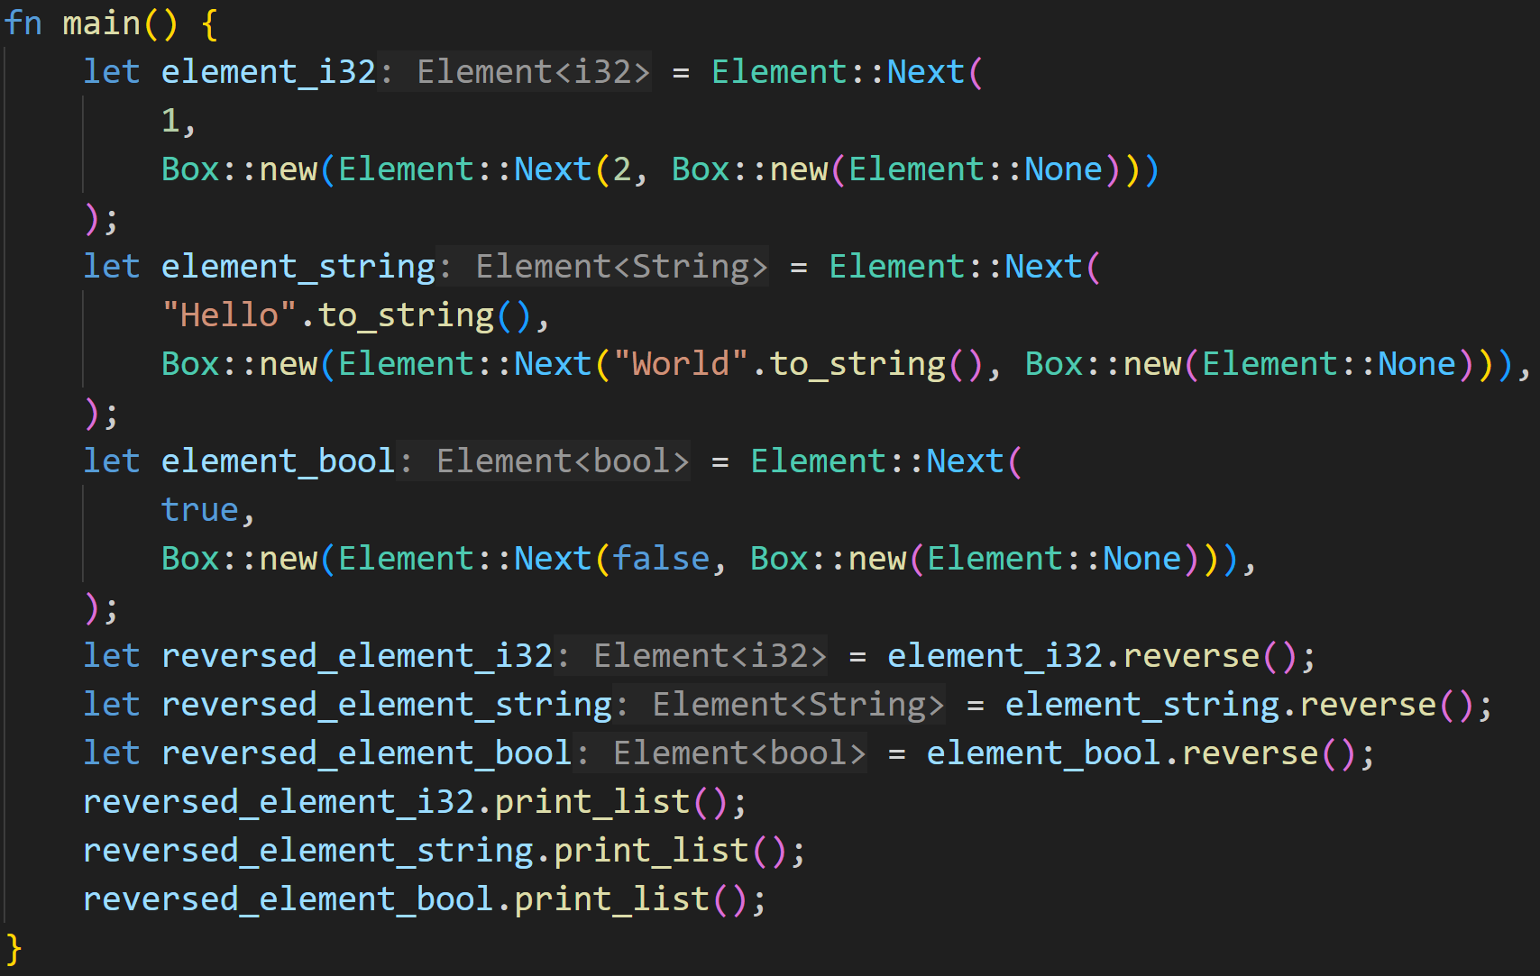
Generics
©Philippe Felix Haupt 2023-2024

Slide 83
Generics
Rust knows which reverse() impl to call in the background
Rust knows which print_list() impl to call in the background
©Philippe Felix Haupt 2023-2024

Slide 84
Generics
element_i32 is of type Element<i32>
reverse() returns type Element<i32>
©Philippe Felix Haupt 2023-2024

Slide 85
Generics
element_string is of type Element<String>
reverse() returns type Element<String>
©Philippe Felix Haupt 2023-2024

Slide 86
Generics
element_bool is of type Element<bool>
reverse() returns type Element<bool>
©Philippe Felix Haupt 2023-2024

Slide 87
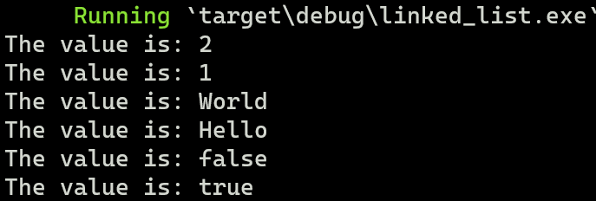
Generics
©Philippe Felix Haupt 2023-2024

Slide 88
Intermission - Exercise
Time for exercises!
©Philippe Felix Haupt 2023-2024

Slide 89
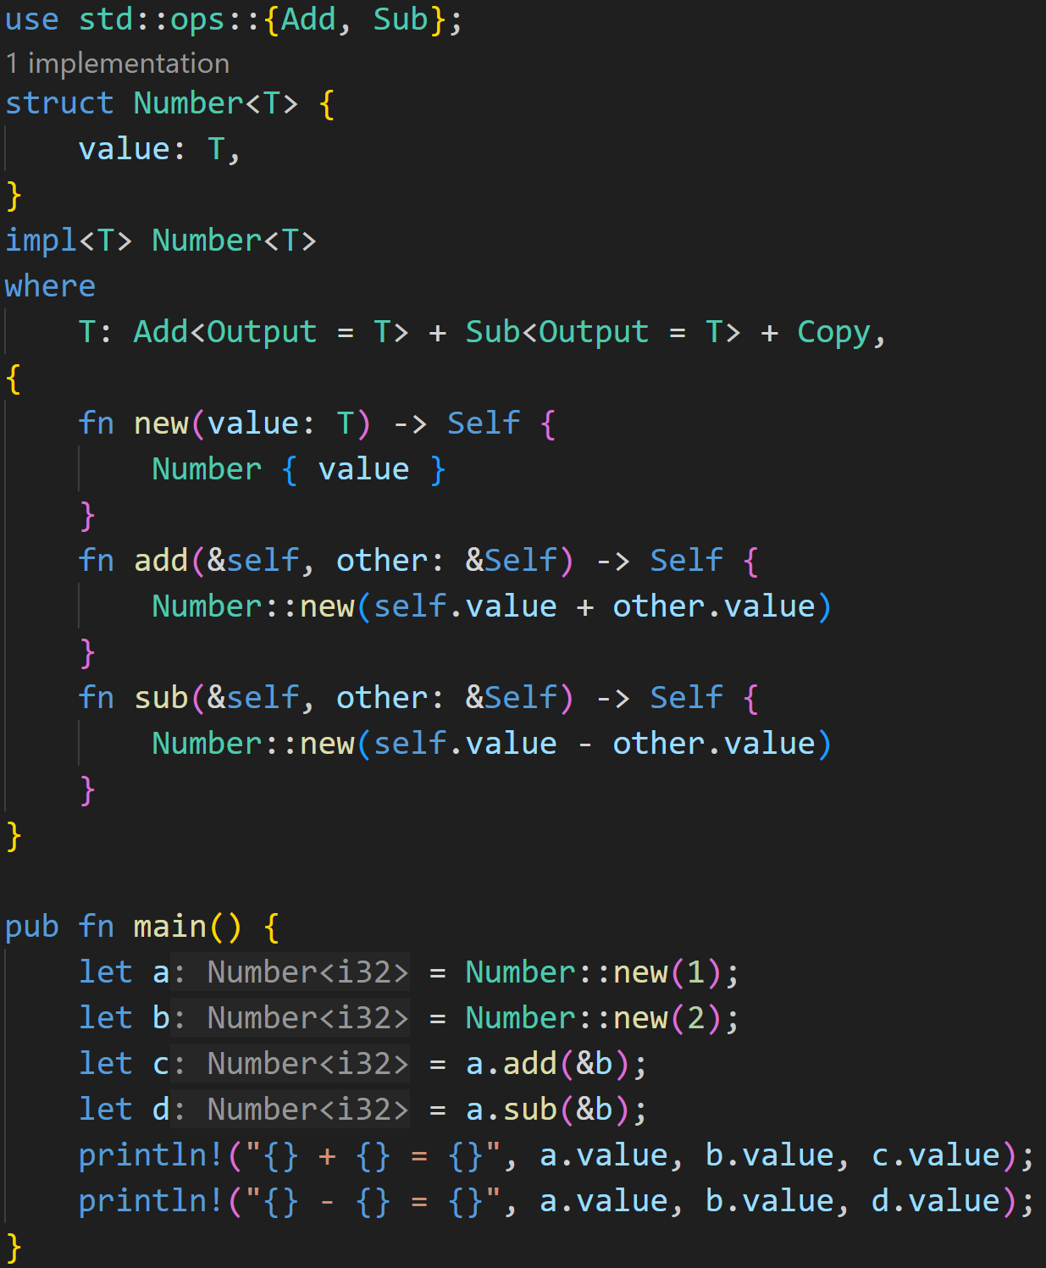
3/3
©Philippe Felix Haupt 2023-2024

Slide 90
3/3
Does this example compile? If yes, what does it print?
Hint: To make your code a bit nicer to read, Rust has the where keyword, it also indicates Trait Boundaries
It’s identical to writing impl<T: Add<...>+Sub<...>+Copy>
©Philippe Felix Haupt 2023-2024

Slide 91
3/3
Does this example compile? If yes, what does it print?
Generic Struct with one Generic Type
Hint: To make your code a bit nicer to read, Rust has the where keyword, it also indicates Trait Boundaries
It’s identical to writing impl<T: Add<...>+Sub<...>+Copy>
©Philippe Felix Haupt 2023-2024

Slide 92
3/3
Does this example compile? If yes, what does it print?
Hint: To make your code a bit nicer to read, Rust has the where keyword, it also indicates Trait Boundaries
It’s identical to writing impl<T: Add<...>+Sub<...>+Copy>
Add<T> is for overloading the + operator
Sub<T> is for overloading the - operator
Output = T is advanced trait stuff and required, we tell the Trait that the result of the +/- operator is of type T
Copy is for self.value and other.value
©Philippe Felix Haupt 2023-2024

Slide 93
3/3
Does this example compile? If yes, what does it print?
Hint: To make your code a bit nicer to read, Rust has the where keyword, it also indicates Trait Boundaries
It’s identical to writing impl<T: Add<...>+Sub<...>+Copy>
Add<T> is for overloading the + operator
Sub<T> is for overloading the - operator
Output = T is advanced trait stuff and required, we tell the Trait that the result of the +/- operator is of type T
Copy is for self.value and other.value
Again: Rust assumes the worst case, so T might as well be an uncopyable type, so it’s moved by default
But it can’t be moved, because we only borrowed self (and therefore self.value), so if we didn’t specify it the code wouldn’t compile
©Philippe Felix Haupt 2023-2024

Slide 94
3/3
Does this example compile? If yes, what does it print?
Hint: To make your code a bit nicer to read, Rust has the where keyword, it also indicates Trait Boundaries
It’s identical to writing impl<T: Add<...>+Sub<...>+Copy>
We create 2 instances of Number<i32>
i32 does implement Add, Sub and Copy, so all Trait Bounds are valid
©Philippe Felix Haupt 2023-2024

Slide 95
3/3
Does this example compile? If yes, what does it print?
Hint: To make your code a bit nicer to read, Rust has the where keyword, it also indicates Trait Boundaries
It’s identical to writing impl<T: Add<...>+Sub<...>+Copy>
We create 2 instances of Number<i32>
i32 does implement Add, Sub and Copy, so all Trait Bounds are valid
There’s nothing special about add() and sub(), Rust would’ve thrown a Compiler Error earlier if Trait Bounds weren’t satisfied, so it works for our i32
©Philippe Felix Haupt 2023-2024

Slide 96
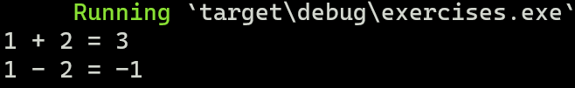
3/3
Does this example compile? If yes, what does it print?
Hint: To make your code a bit nicer to read, Rust has the where keyword, it also indicates Trait Boundaries
It’s identical to writing impl<T: Add<...>+Sub<...>+Copy>
We create 2 instances of Number<i32>
i32 does implement Add, Sub and Copy, so all Trait Bounds are valid
There’s nothing special about add() and sub(), Rust would’ve thrown a Compiler Error earlier if Trait Bounds weren’t satisfied, so it works for our i32
The code compiles :)
©Philippe Felix Haupt 2023-2024

Slide 97
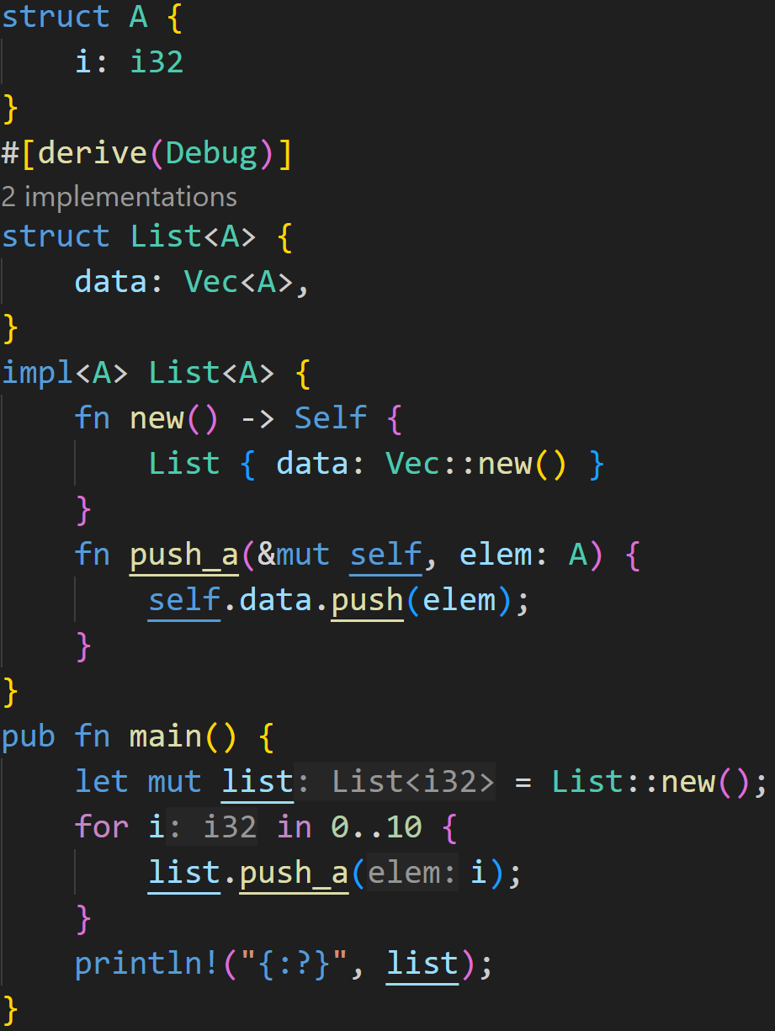
2/3
©Philippe Felix Haupt 2023-2024

Slide 98
2/3
Does this example compile?
If yes, what does it print?
©Philippe Felix Haupt 2023-2024

Slide 99
2/3
Does this example compile?
If yes, what does it print?
There’s nothing special about this code, our List is a simple Wrapper for Vectors
©Philippe Felix Haupt 2023-2024

Slide 100
2/3
Does this example compile?
If yes, what does it print?
There’s nothing special about this code, our List is a simple Wrapper for Vectors
We implement a simple function to push elements
©Philippe Felix Haupt 2023-2024

Slide 101
2/3
Does this example compile?
If yes, what does it print?
There’s nothing special about this code, our List is a simple Wrapper for Vectors
We implement a simple function to push elements
However, this A is the Generic Type, not the Struct!
In general, generic types shadow other type definitions
We never use struct A anywhere in this code.
©Philippe Felix Haupt 2023-2024

Slide 102
2/3
Does this example compile?
If yes, what does it print?
Last thing to check is traits, our generic type needs to implement the Debug trait, which i32 does, so we can derive the Trait without any worries
©Philippe Felix Haupt 2023-2024

Slide 103
2/3
Does this example compile?
If yes, what does it print?
Last thing to check is traits, our generic type needs to implement the Debug trait, which i32 does, so we can derive the Trait without any worries
This code compiles :)
©Philippe Felix Haupt 2023-2024

Slide 104
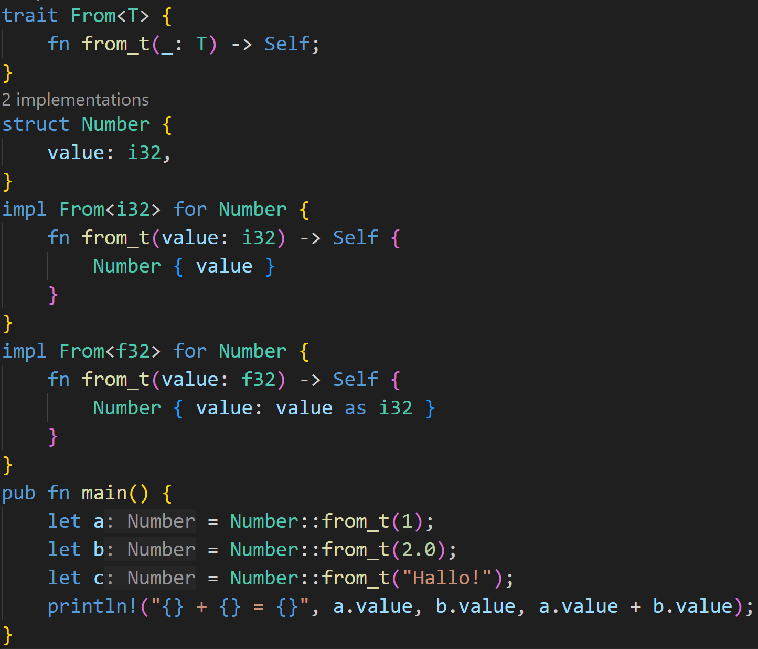
2/3
©Philippe Felix Haupt 2023-2024

Slide 105
2/3
Does this example compile?
If yes, what does it print?
©Philippe Felix Haupt 2023-2024

Slide 106
2/3
Does this example compile?
If yes, what does it print?
We can also make Traits generic, this is a small trait to convert types into each other
©Philippe Felix Haupt 2023-2024

Slide 107
2/3
Does this example compile?
If yes, what does it print?
If we implement the trait for a given type, we also need to change the signature accordingly
From<i32> takes a i32 as parameter
From<f32> takes a f32 as parameter
©Philippe Felix Haupt 2023-2024

Slide 108
2/3
Does this example compile?
If yes, what does it print?
f32 to i32 is almost always lossy :^) but it’s okay
©Philippe Felix Haupt 2023-2024

Slide 109
2/3
Does this example compile?
If yes, what does it print?
HOWEVER: We did not implement From<&str>!
©Philippe Felix Haupt 2023-2024

Slide 110
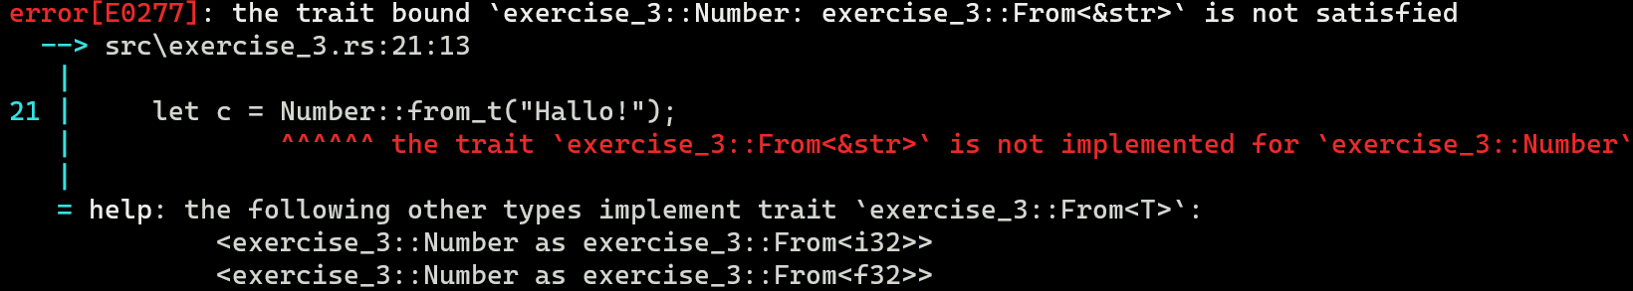
2/3
Does this example compile?
If yes, what does it print?
This code does not compile
©Philippe Felix Haupt 2023-2024

Slide 111
Next time
Option<T>
Result<T, E>
? operator
©Philippe Felix Haupt 2023-2024

